Slide 1

Süleyman Bozkurt – DynaTMT changes-updates

Slide 2
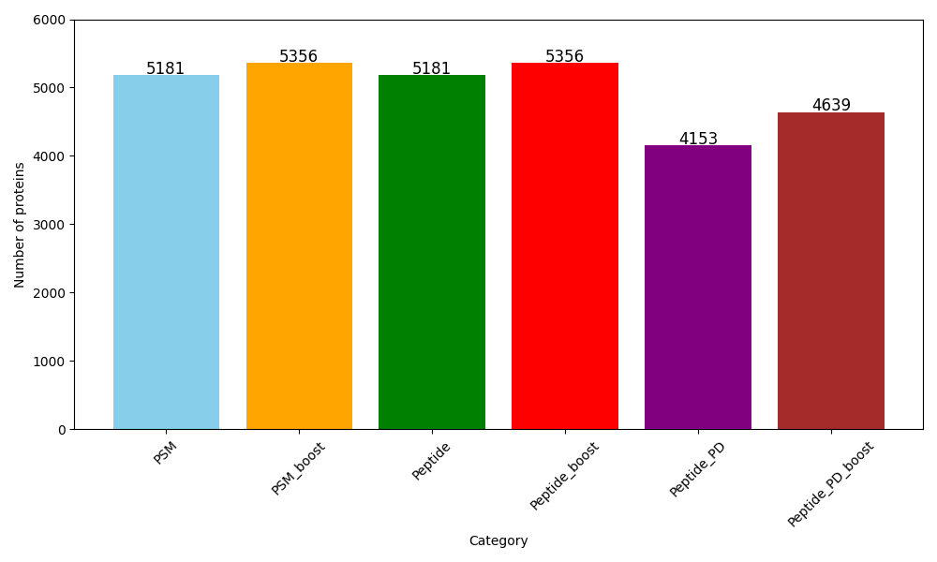
Number of the proteins from different analysis from the same experiment
New function
No IT adjustment
CCCP and CCCP-ISRIB data is used from mePRODmt paper

Slide 3
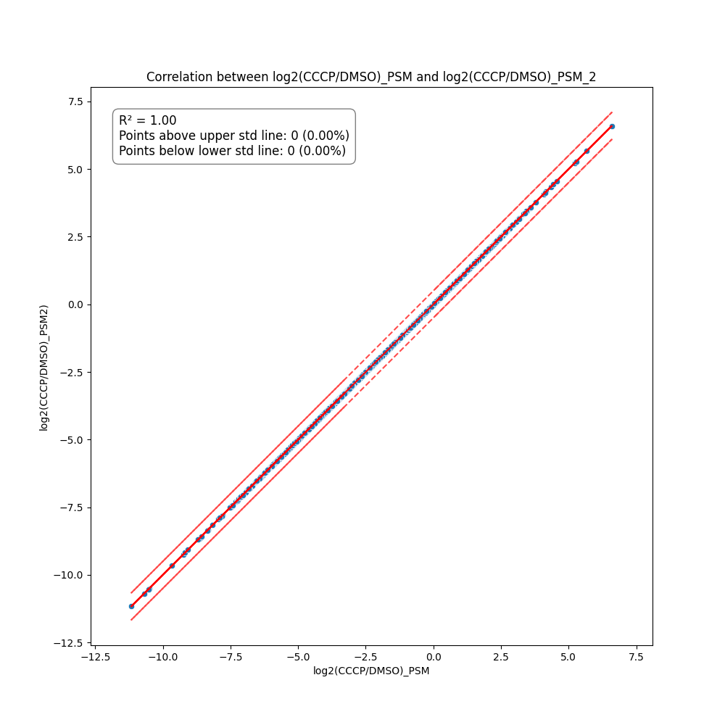
Understand the effect of Random = True (PSMs were used)
Red lines indicates 0.5 fold changes high and low
Random test: no difference – tested 3 times with same data
Random numbers is between 0 to 1.

Slide 4
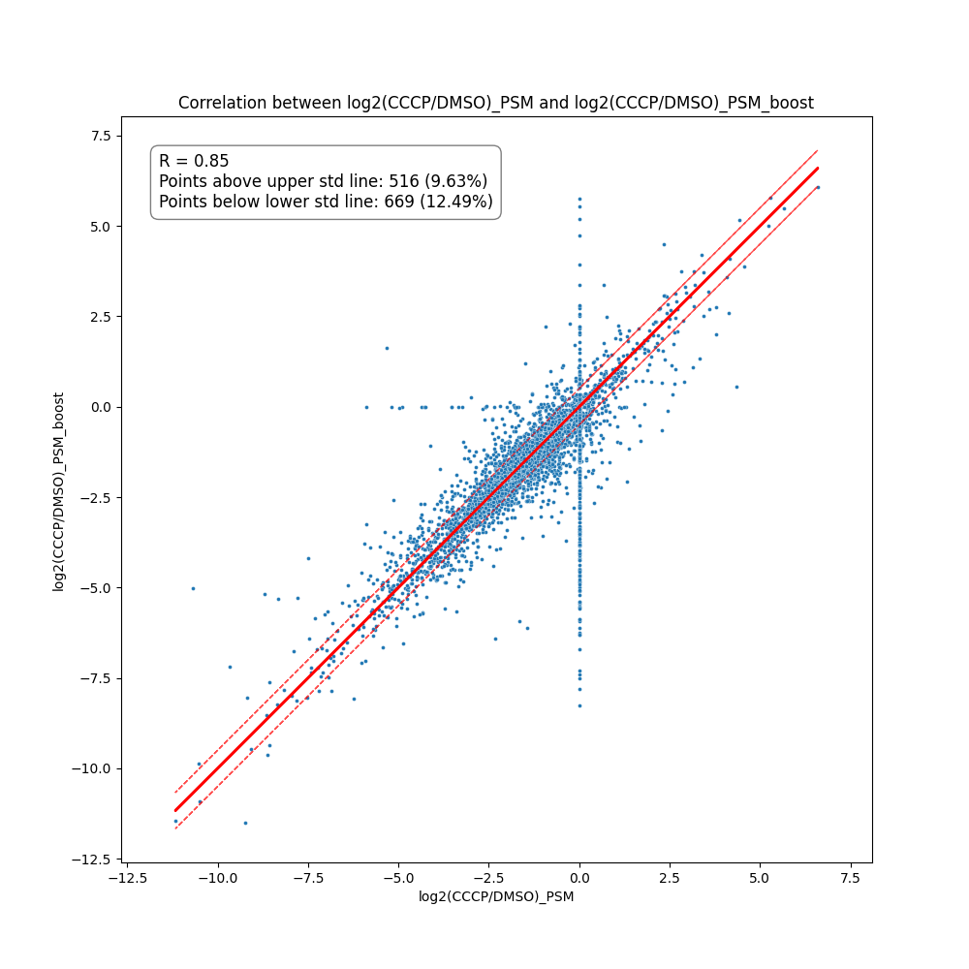
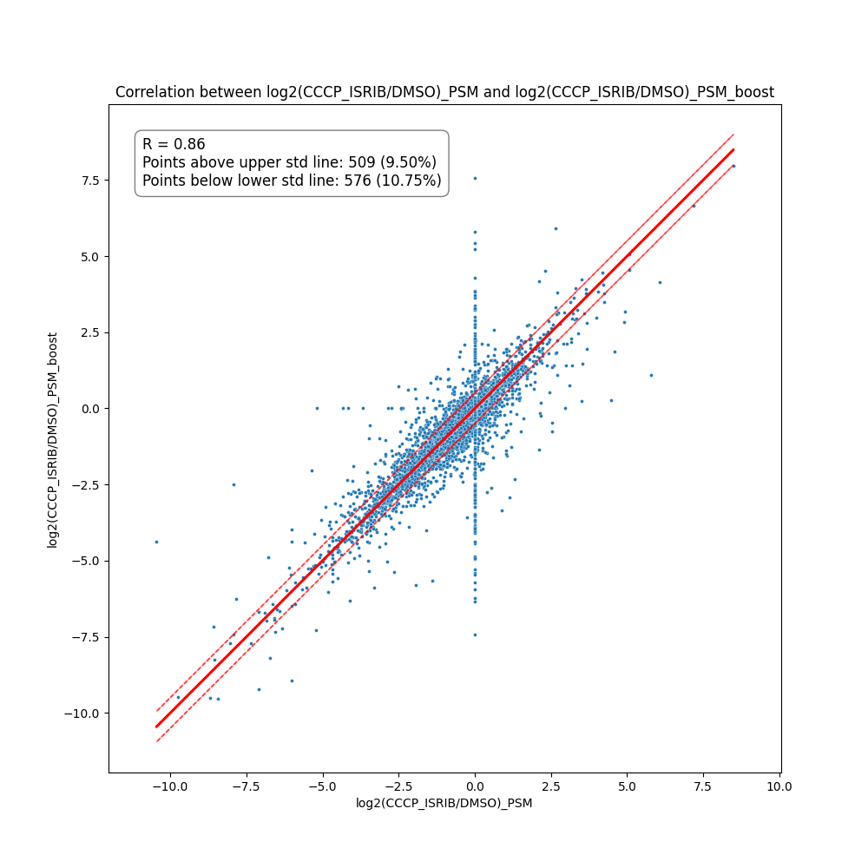
Understand the effect of Boost in the analysis (PSMs were used)
Samples : CCCP vs DMSO
Samples : CCCP+ISRIB vs DMSO
Merge with all accessions

Slide 5
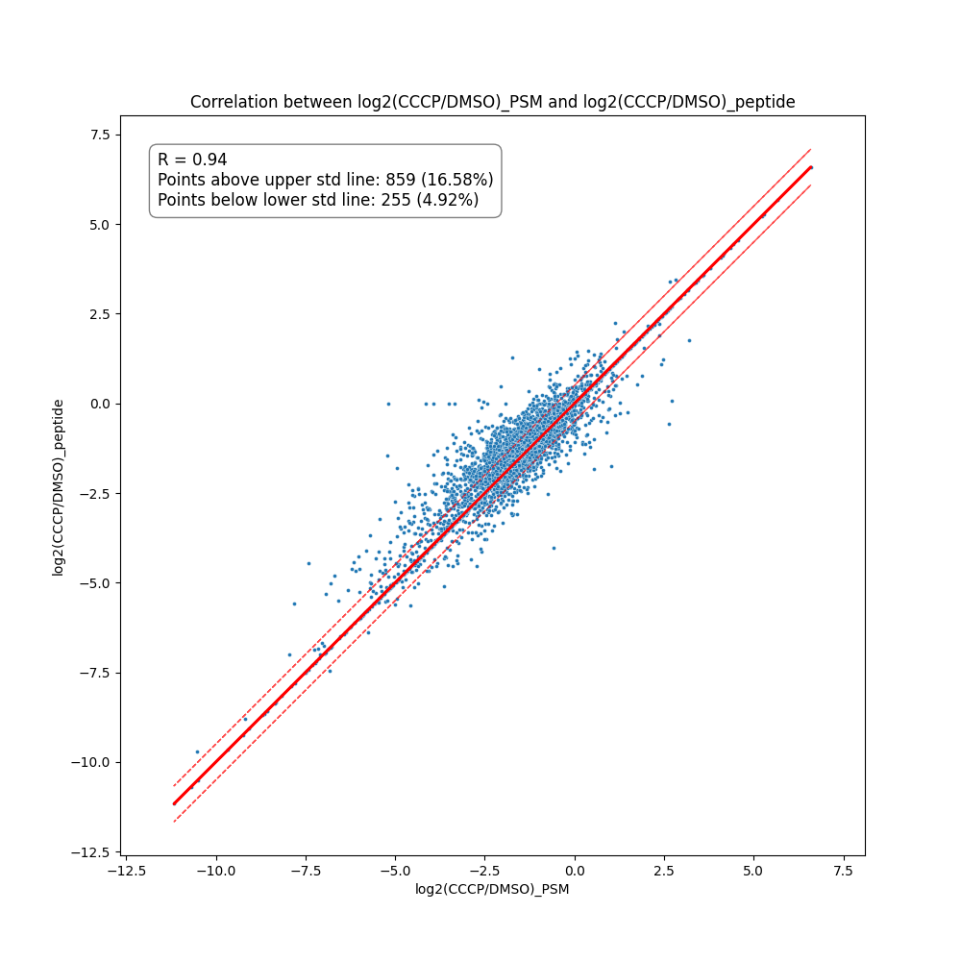
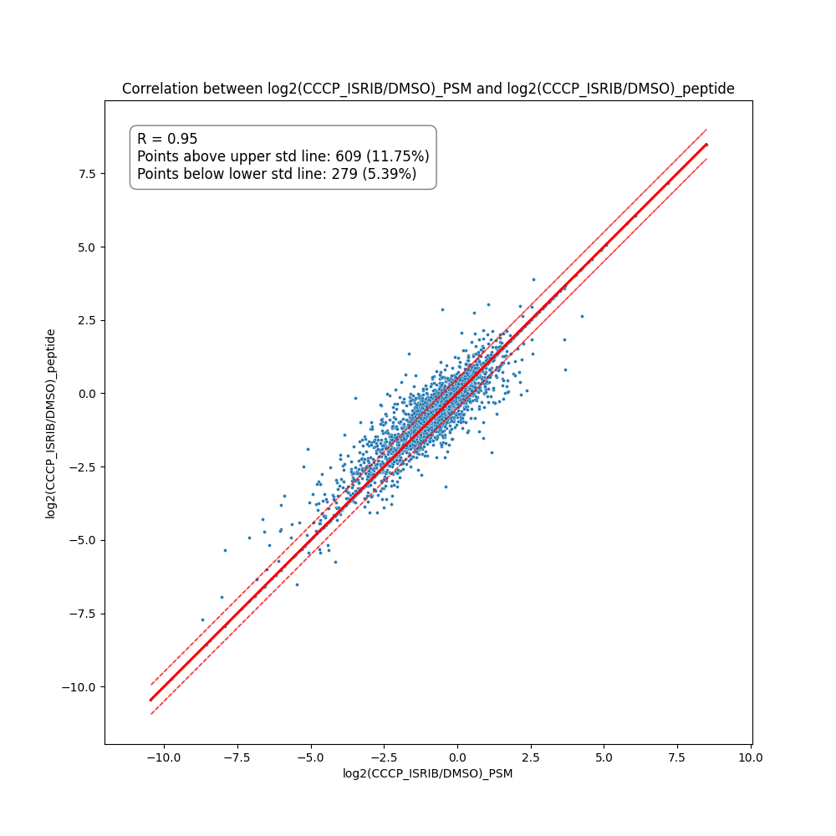
Old peptide return function vs new function (PSM file is used)
Samples : CCCP vs DMSO
Samples : CCCP+ISRIB vs DMSO
Merge with all accessions

Slide 6
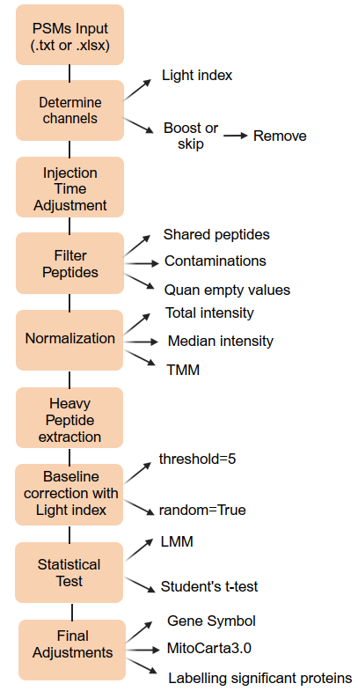
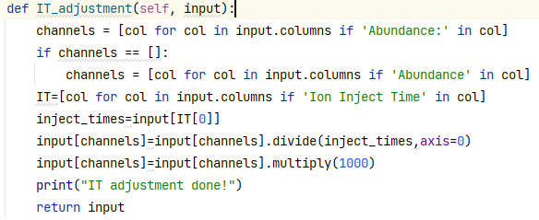
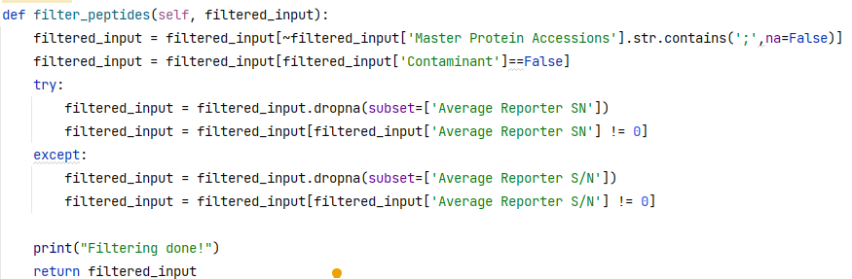

Slide 7
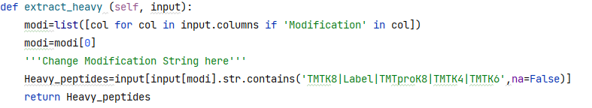
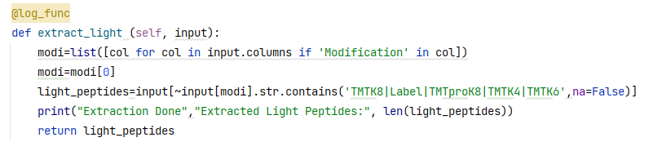

Slide 8
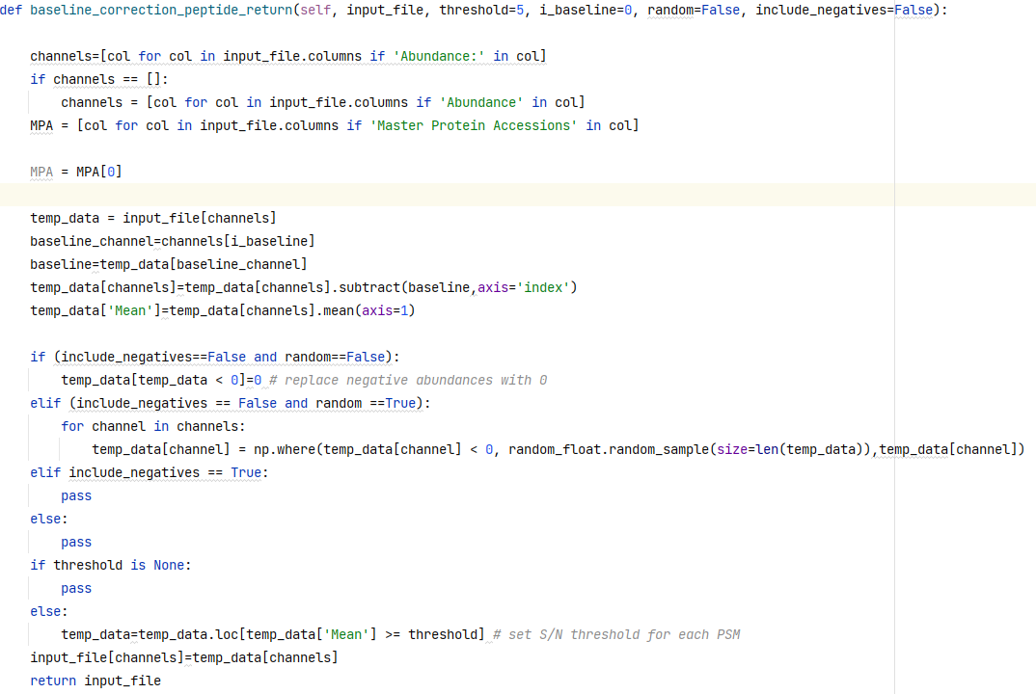
Baseline correction old function 1 (peptide return)

Slide 9
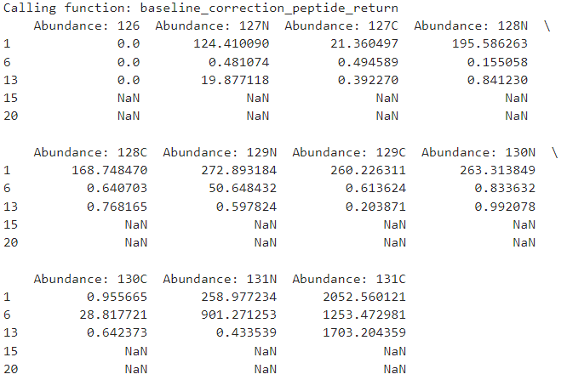
Baseline correction old function 1 (peptide return) Result
Number of PSMs: 72,814
After baseline correction

Slide 10
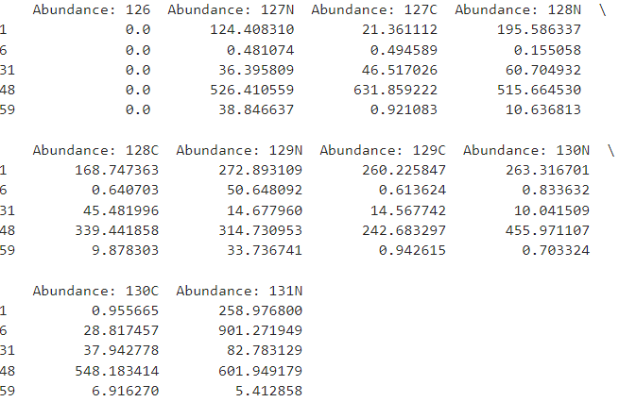
Baseline correction old function 1 (peptide return) Result - filtered
Number of PSMs: 59,832
After baseline correction

Slide 11
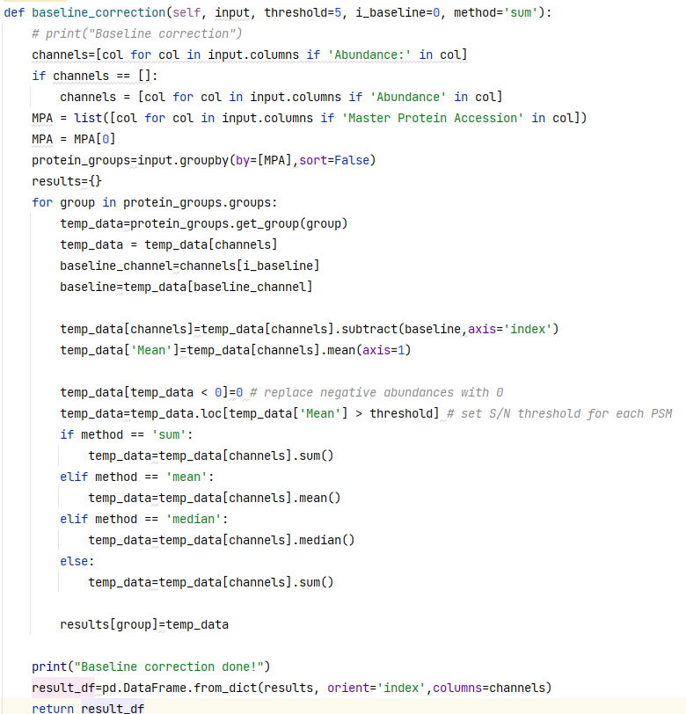
Baseline correction old function 2 (protein return)

Slide 12
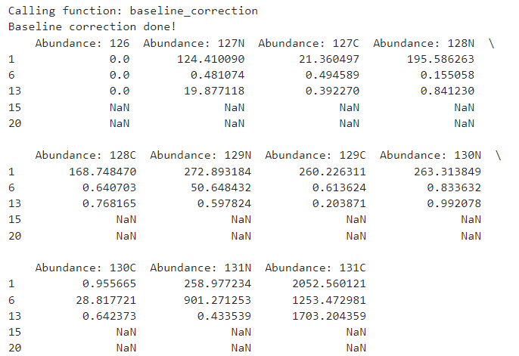
Baseline correction old function 2 (protein return)
Number of PSMs: 5,466
After baseline correction

Slide 13
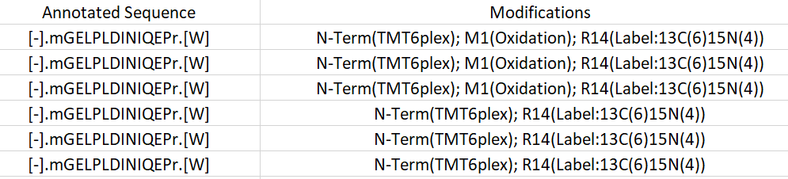
PSMs level
Peptide group level

Slide 14
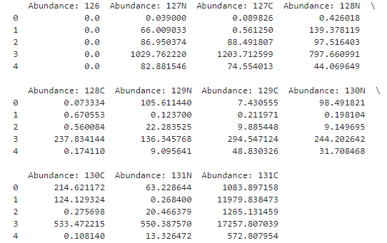
New Baseline correction function
Number of PSMs: 34,318
After baseline correction

Slide 15
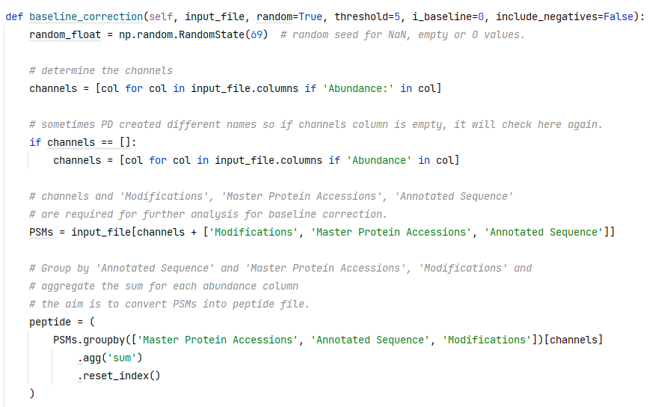
New Baseline correction function
Determine channels
Determine only required columns
Group and sum of the same PSMs into peptides by modifications, sequence and accession ID

Slide 16
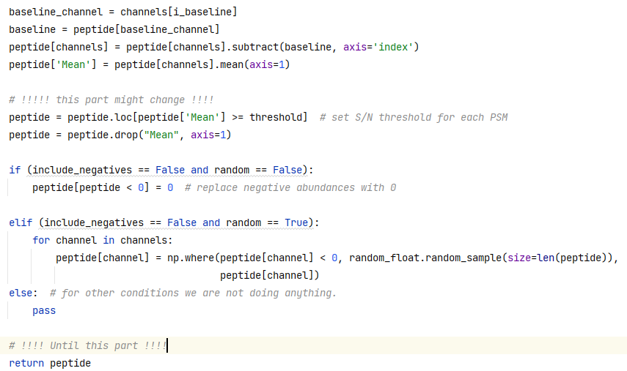
Determine baseline location and column
Substract baseline from other channels
Mean of columns (including negatives)
Remove columns which the mean is less than threshold sett
Make columns 0 which has negative values
Make 0 values some random small number

Slide 17

THANKS

Slide 18
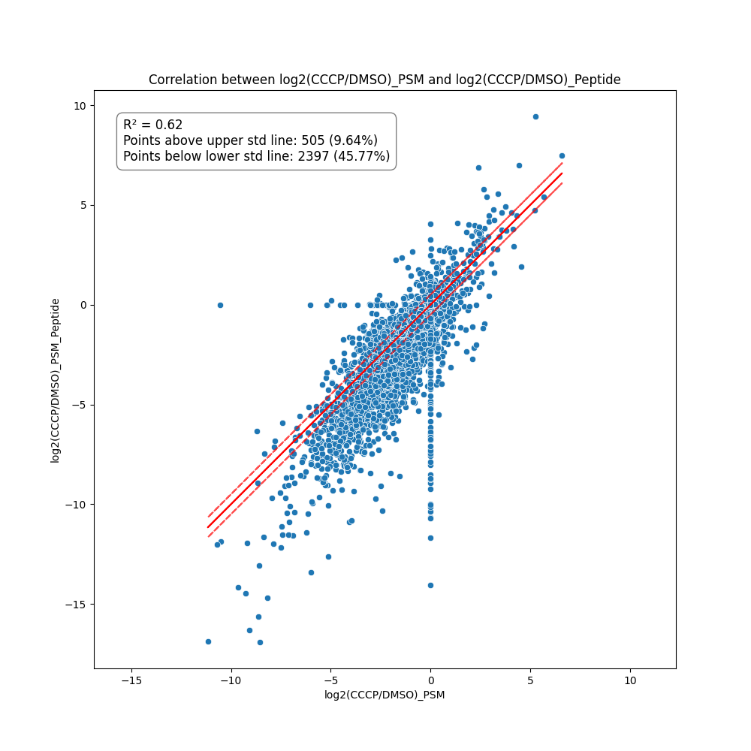
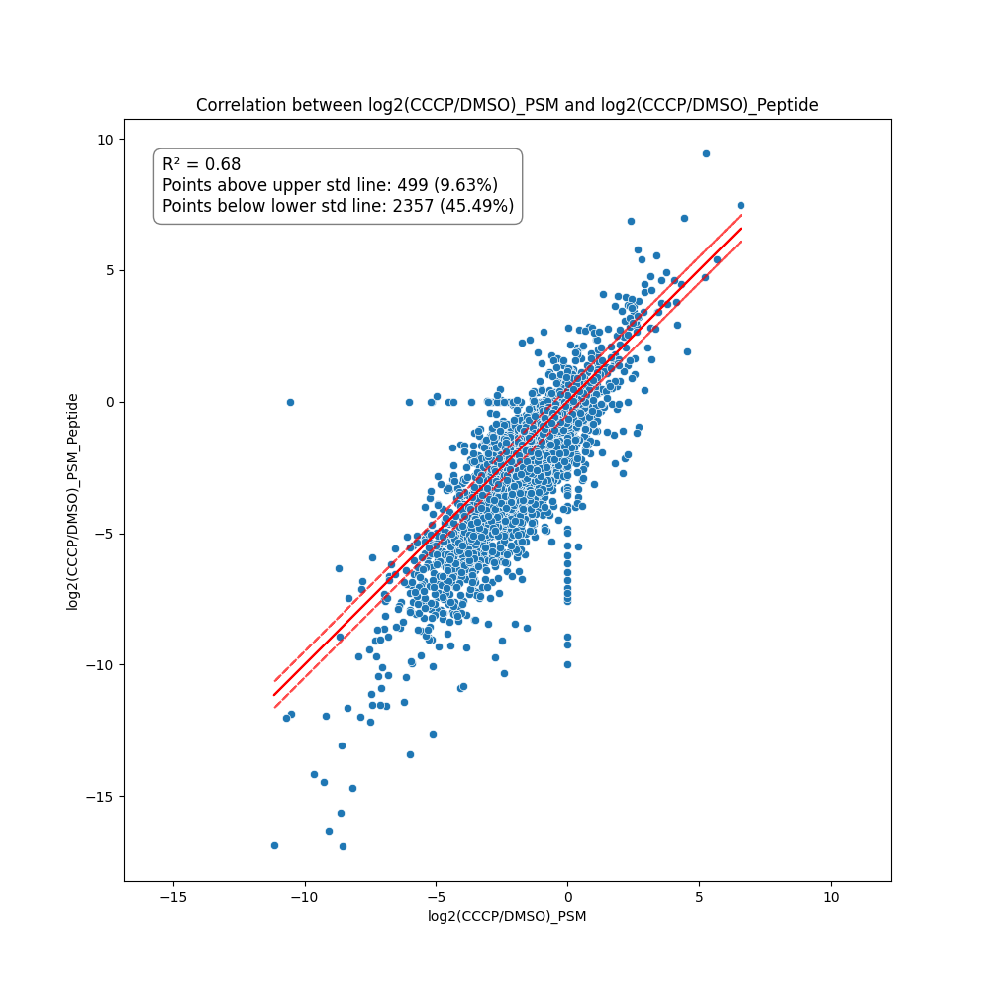
No Booster used!
Understand the effect of PSM calculation vs peptides in LMM
PSMs vs Peptides
PSMs vs Peptides
Samples : CCCP vs DMSO
Samples : CCCP vs DMSO
Merge with all accessions
Merge with only common accessions

Slide 19
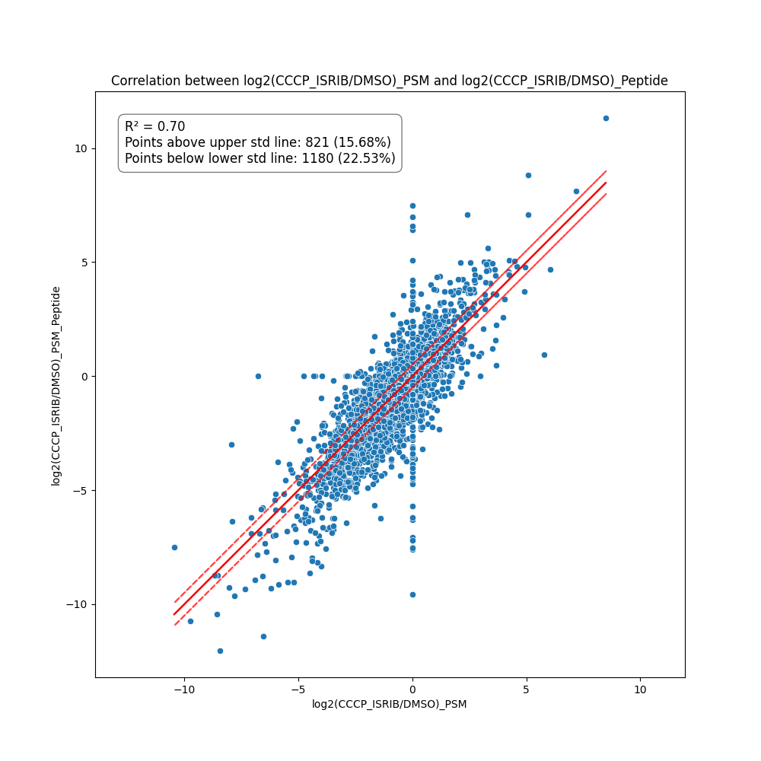

No Booster used!
Understand the effect of PSM calculation vs peptides in LMM
PSMs vs Peptides
PSMs vs Peptides
Samples : CCCP+ISRIB vs DMSO
Samples : CCCP+ISRIB vs DMSO
Merge with all accessions
Merge with only common accessions

Slide 20
